Slide 1

ECB1204 – ANALOG INTEGRATED CIRCUIT DESIGN MODULE 1 - IMPLEMENTATION MELODIC TONEGENERATOR USINGIC 555 TIMER
Presented by:
BALAJI K (2303811710621014)
KANNAN M(2303811710621050)
KARTHIK S (2303811710621051)
Under the Guidance of
PARTHIPARAJ
ASSISTANT PROFESSOR
ECE

Slide 2
OUTLINE
ABSTRACT –MODULE 1
INTRODUCTION
BLOCK DIAGRAM
HARDWARE REQUIREMENT
ADVANTAGES AND APPLICATIONS
CONCLUSION
PROJECT PLAN
REFERENCES

Slide 3
MODULE 1 – IMPLENTATION MELODIC TONE GENERATOR USING IC 555 TIMER

Slide 4
ABSTRACT - MODULE 1
This project demonstrates the design and implementation of a melodic tone generator using the versatile IC 555 timer. The IC 555 is configured in astable mode to produce square wave signals of varying frequencies, which generate audible tones when connected to a speaker.
To create a melody, either a manual selection mechanism using switches or an automated system driven by a microcontroller can be employed. The project finds applications in musical toys, doorbells, and sound effects systems, showcasing the IC 555 timer’s capability as a cost-effective and reliable solution for generating melodic tones. This circuit provides a practical introduction to sound synthesis and frequency modulation principles in electronics.

Slide 5
INTRODUCTION – MODULE 1
The generation of musical tones forms the foundation of various audio devices, including doorbells, alarms, and entertainment systems. Among the many tools available to design tone generators, the IC 555 timer stands out as a reliable and versatile component for producing square wave signals at different frequencies. Its simplicity, cost-effectiveness, and wide availability make it an ideal choice for hobbyists and professionals alike.
This project focuses on developing a melodic tone generator by configuring the IC 555 timer in astable mode, where it operates as a square wave oscillator. By altering the resistance and capacitance in its circuit, the frequency of oscillation can be changed to produce distinct tones corresponding to musical notes.

Slide 6
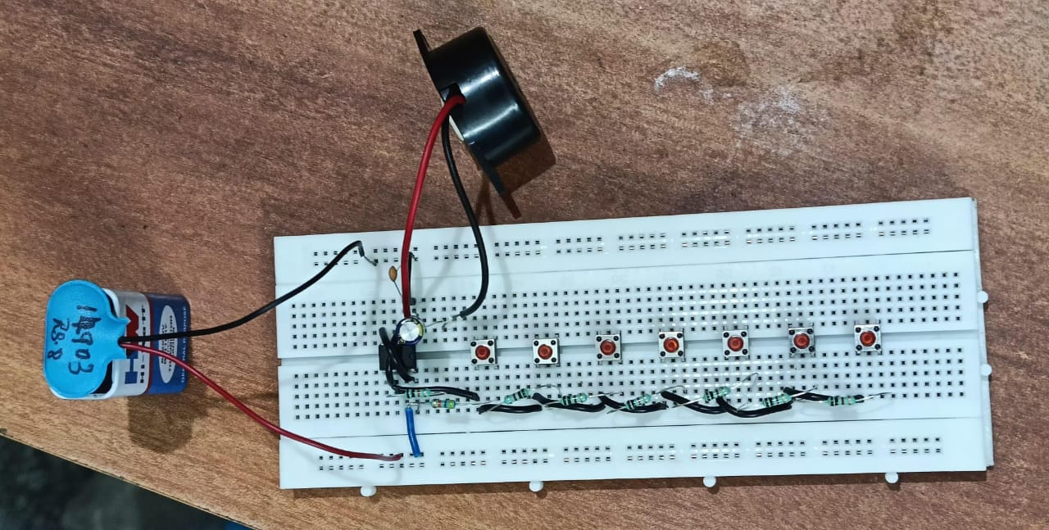
CIRCUIT DIAGRAM

Slide 7
HARDWARE MODULE
Hardware which used in our proposed system :
IC 555
BUTTON
RESISTOR
CAPACITOR
BUZZER
BREAD BOARD

Slide 8
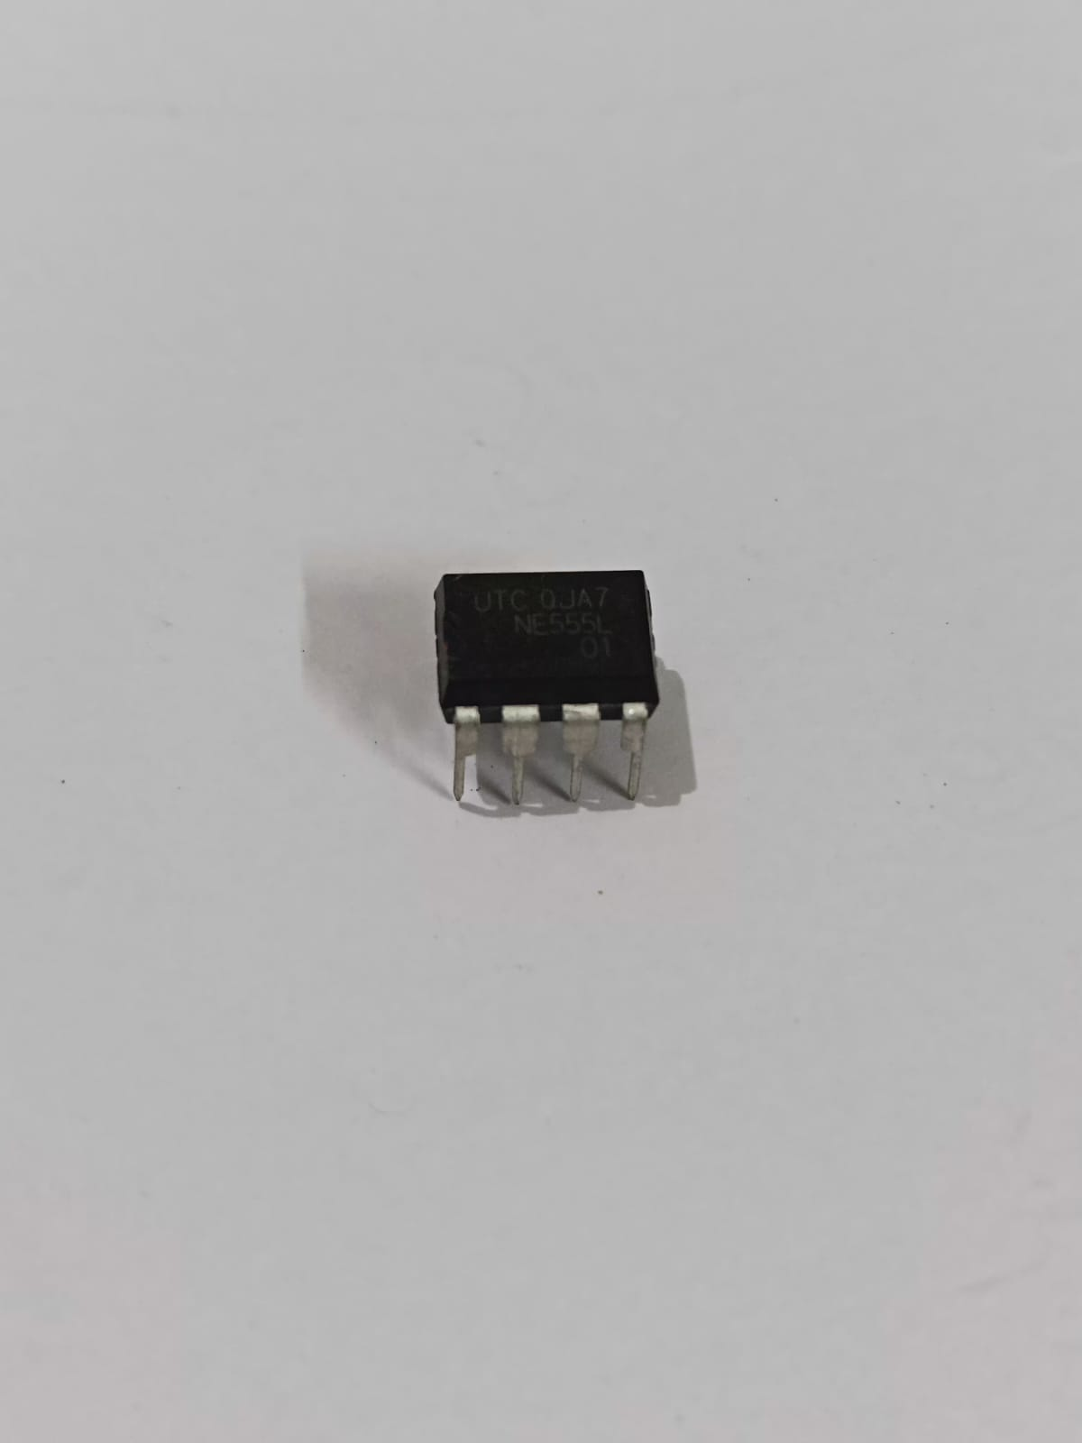
IC 555
The IC 555 timer is a widely used integrated circuit in electronics due to its versatility, simplicity, and low cost. It is capable of generating precise timing, oscillation, and pulse-width modulation, making it a staple in many applications like timers, pulse generators, waveform generators, and control circuits.

Slide 9
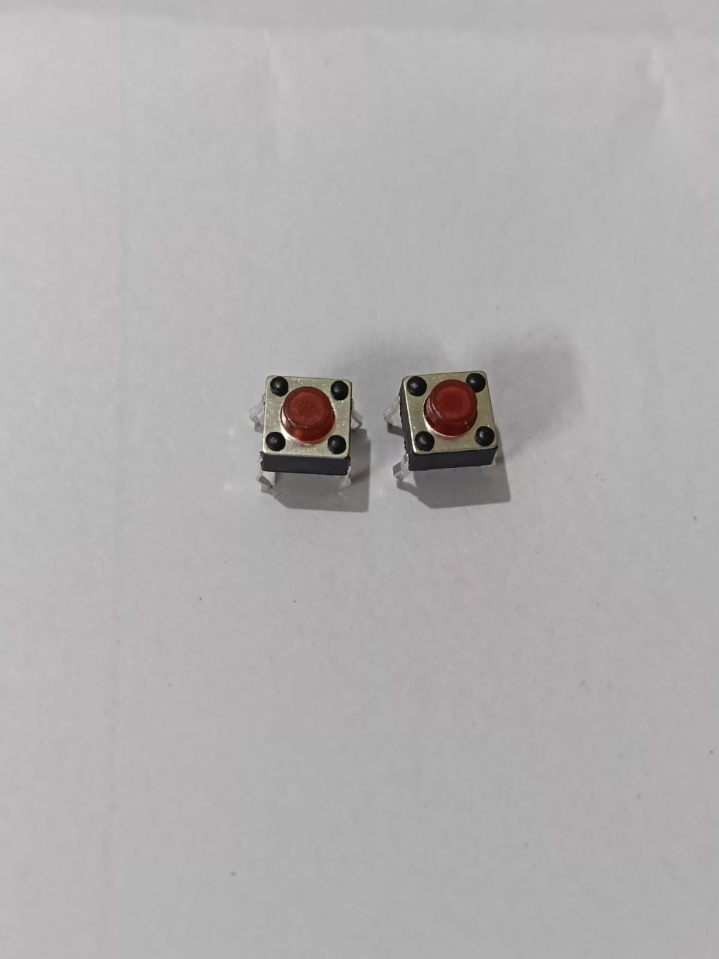
BUTTON
Buttons, also known as push buttons or switches, are simple and widely used input devices in electronic circuits. They are designed to make or break an electrical connection when pressed, providing a way for users to interact with a device. Buttons are fundamental components in user interfaces, control panels, and interactive systems.

Slide 10

CAPACITORS
A capacitor is a passive electronic component that stores electrical energy in an electric field. It is one of the fundamental building blocks in electronics, widely used for energy storage, filtering, timing, and coupling applications. A capacitor consists of two conductive plates separated by an insulating material called a dielectric.

Slide 11
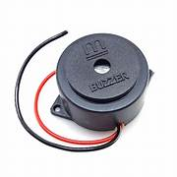
BUZZER
A buzzer is an audio signaling device commonly used in electronic circuits to produce sound. It generates a tone, beep, or alarm when powered, making it an essential component in alerting and notification systems. Buzzers come in various types, such as mechanical, electromechanical, and piezoelectric, each suited for specific applications.

Slide 12
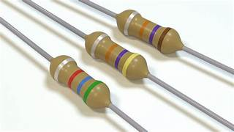

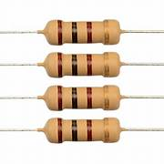
RESISTOR
Resistors are fundamental passive components in electronics that control the flow of electrical current and distribute voltage in circuits. They are characterized by their resistance value, which is measured in ohms (Ω). By opposing the flow of current, resistors help protect sensitive components, create voltage dividers, and set operating conditions in circuits.

Slide 13
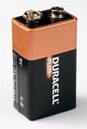
POWER SUPPLY
A regulated power supply is an essential tool in electronics that provides a constant and stable output voltage or current to a circuit or device. Unlike unregulated power supplies, an RPS compensates for input voltage fluctuations and load variations, ensuring that the connected circuit receives a steady and clean power source.

Slide 14
ADVANTAGES AND APPLICATIONS
MUSICAL TOYS
DOOR BELLS
ALARM SYSTEM
ALERT AND NOTIFICATION SYSTEM

Slide 15
CONCLUSION
The melodic tone generator designed with the IC 555 timer serves as an effective and versatile solution for producing audible tones. By utilizing the IC 555 in astable mode, this circuit can generate square wave oscillations at variable frequencies, allowing it to produce different musical notes or sound effects. The simplicity of the 555 timer, combined with the flexibility of adjusting the resistor and capacitor values, makes this design both cost-effective and easy to implement.
This project has demonstrated the practical applications of the 555 timer in generating melodies for various devices such as toys, alarms, doorbells, and notification systems. It also serves as an excellent learning tool for understanding basic electronic principles, including frequency generation, oscillation, and sound synthesis.

Slide 16
PROJECT PLAN
The project plan for developing a melodic tone generator using an IC 555 timer outlines a structured approach to designing and implementing the circuit.
The primary objective is to create a tone generator capable of producing different musical notes or sound effects, leveraging the IC 555 timer in astable mode to generate variable frequency oscillations.
The project is divided into several phases, starting with research and planning, where the team will study the working of the IC 555 timer, define project goals, and design the schematic.

Slide 17
REFERENCES
"IC 555 Timer: Theory, Operation, and Applications" – Electronics Tutorials This tutorial provides an in-depth look at the working principles of the IC 555 timer, its modes of operation (astable, monostable, bistable), and practical circuit applications. Electronics Tutorials - IC 555 Timer
"555 Timer Circuits" – National Semiconductor (Application Notes) National Semiconductor provides various application notes detailing different circuits using the IC 555, including tone generators, oscillators, and timers. National Semiconductor 555 Timer Circuits
"555 Timer Cookbook" – Don Lancaster This book is an excellent reference for understanding how to design with the IC 555 timer and includes multiple examples of circuits, including tone generators. 555 Timer Cookbook by Don Lancaster

Slide 18
THANK YOU

